Slide 1

Fellowship Family Church
F.F.C
Acts 4:11v He is "'the stone you builders rejected, which has become the capstone

Slide 2
Building Project for
Fellowship Family Church
Isaiah: 55:1v
"Come, all you who are thirsty, come to the waters; and you who have no money, come, buy and eat! Come, buy wine and milk without money and without cost.

Slide 3
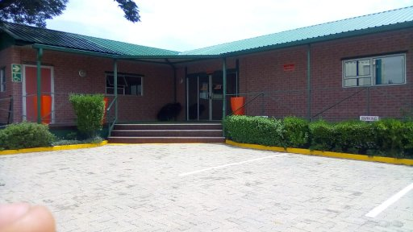
Our New Church Building
Plot 99 Pelindaba Road Lanseria Johannesburg South African on the same land it is where we will put our movable container

Slide 4
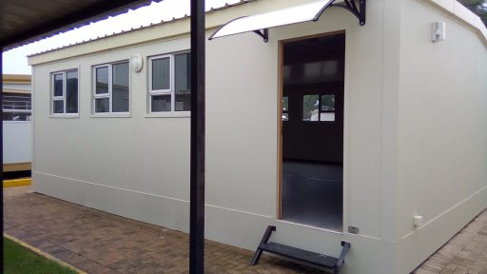
Our New Church Building
Plot 99 Pelindaba Road Lanseria Johannesburg South African

Slide 5
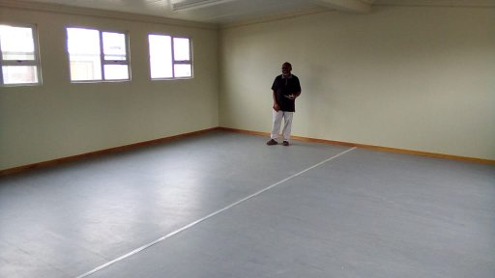
Building container that will become a Church Hall inside of the church Hall
After praying and hearing God we were led to ask for space where we could put our tent to worship on Sunday. Its from the contact with Mr François. We will be authorised to put our tent, 3 month after we faced challenges of removing and putting the tent. With the church we felt we could ask if we can use the house that was abandoned, Mr François said to us we must first assess the building if it is still in the good condition. On the 11th November 2018 we met with one of the constructer who come to assess the premises. After his assessment he told us.
The house foundation was still good
The flow of the house was still fine
The top wall of the house was still fine
After showing Him what we would like to do for the place, it is when we presented our plan of rehabilitating that house we did decided to do it in two phases.
Phase One
Phase Two
The cost of the two phases went very high, knowing that if the place get sold out. We will loose that building, that why we went in the prayer asking God to give other solution. After searching we found that, he could be beta for us to use movable container. That we can move once we get our own land where we will build our permanent church facilities.
Phase Three
Church equipment , children ministry plus office that will be also using containers. In the week it will be pre-school

Slide 6
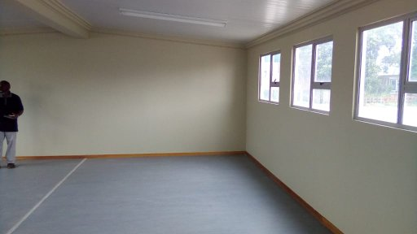
Phase One Church Hall and toiles plus two Containers main Church Hall
After having the church hall and Pastor office they will be a need of getting other 4 containers. That will be utilise as youth and children ministry classes during the week end. And Monday to Friday it will be a pre-school to help our community and also to create job to our church members. That’s why we did propose if they could allow us to use the free space in they are land.
Church Facility
Main Hall
1 Office
4 class rooms
1 kitchen
1 toilet
By having this containers is what will allow our church to operate fully with all our phase one project what is
Pre-school
Soup kitchen .

Slide 7
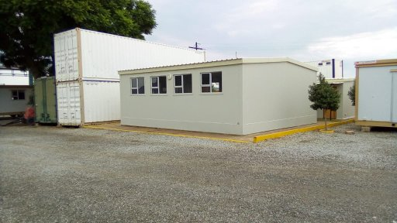
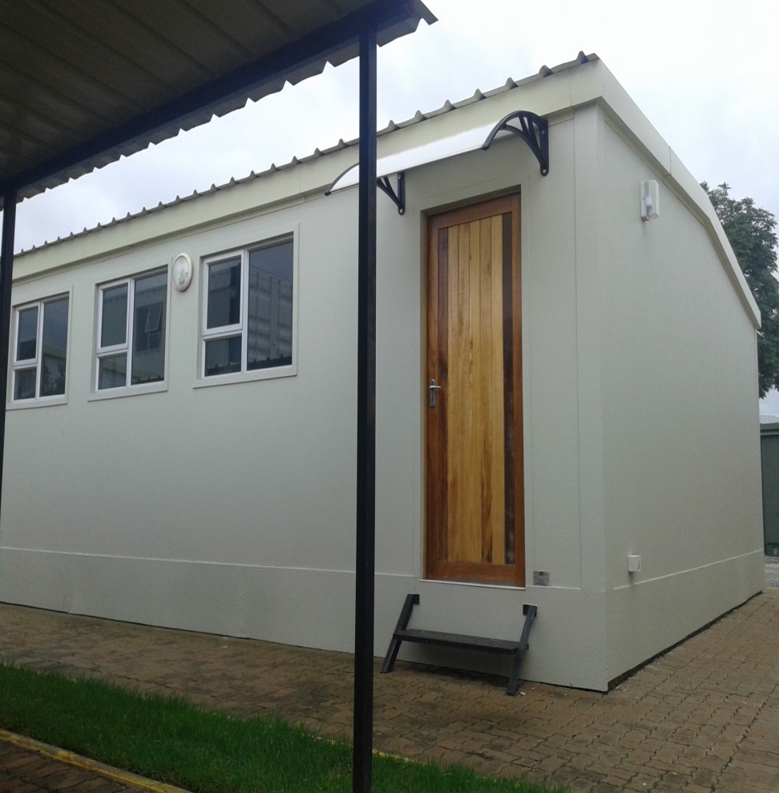
Phase One Church Hall and Office plus toiles
Main entrance of the Church
Left side of the building is the church Hall

Slide 8
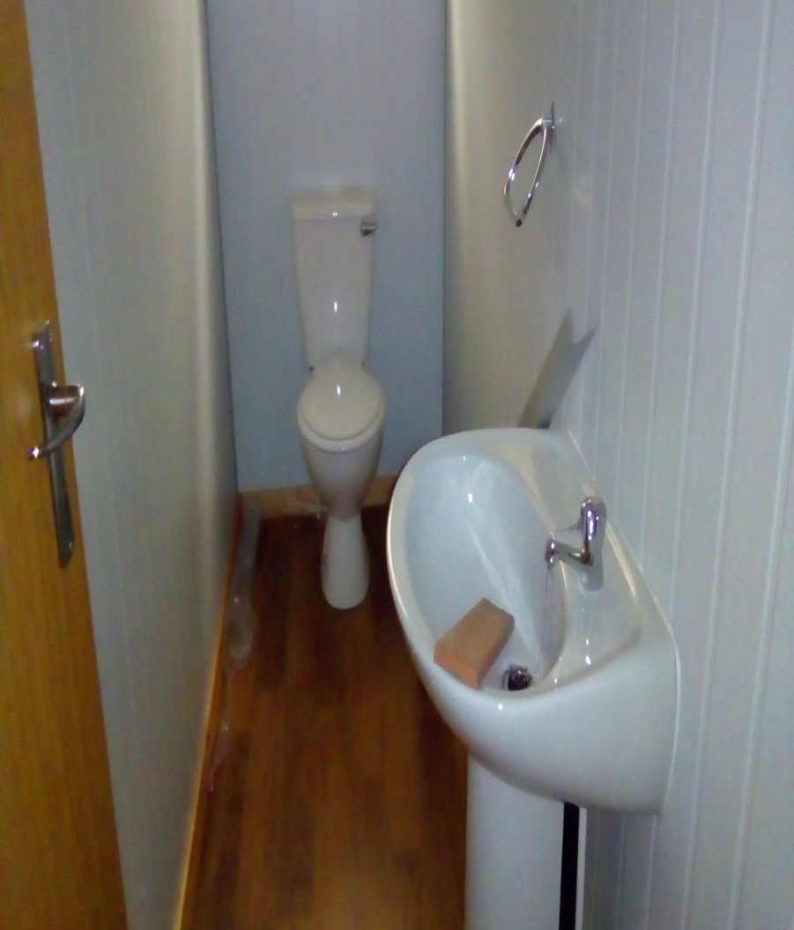
Information about the container that we will use us Church Hall
To build it is taking three to four week maximument. Before the start building they need 50% of the cost of the building. Once done you paid the balance of 50% was remaining. This are the size of each building
Main Hall is 8,0m x 7,0m
1 Office 6,0m x 3,0m
1 toilet 6,0m x 2,4m
By having this containers is what will allow our church to operate fully. Having an holistic approach we will like the church premise to function fully from Sunday to Sunday. During the week class will be utilise as pre-school what is our phase two of our project what is
4 class rooms (Pre-school ) 6,0mm x 3,0m
Soup kitchen . 6,0mm x 3,0m

Slide 9
The Cost of Phase One Church Hall with toiles
No | items | Quantity | Total amount | Dollar $
01 | Church Hall | 1 | R 195 000.00 | $ 13,928.00
02 | Delivery on site | Once | R 6,050.00 | $ 432.00
03 | Joining model on site | Once | R 6,500.00 | $ 464.28
04 | Blinds | 5 x | R 4,430.00 | $ 316.42
05 | Burglar bars | 5 x | R 3,395.00 | $ 242.50
06 | Security Gate | 1 x | R 1,869.00 | $ 133.50
07 | Two tier steel | 1 x | R 950.00 | $ 67.85
08 | Chalk Board | 2 x | R 3,314.00 | $ 236.71
09 | Pin Boards | 2 x | R 1,953.00 | $ 139.50
10 | Veranda | 1 x | R 5,700.00 | $ 407.14
 | Total Amount : |  | R 229,161.00 | $ 16,368.00

Slide 10
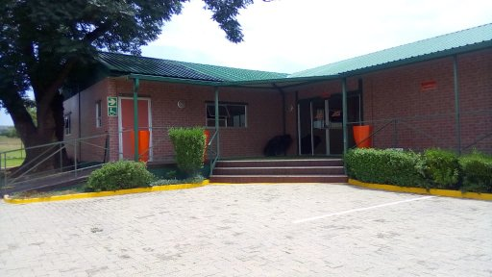
The Cost of Phase Two Church Children Ministry Class rooms

Slide 11
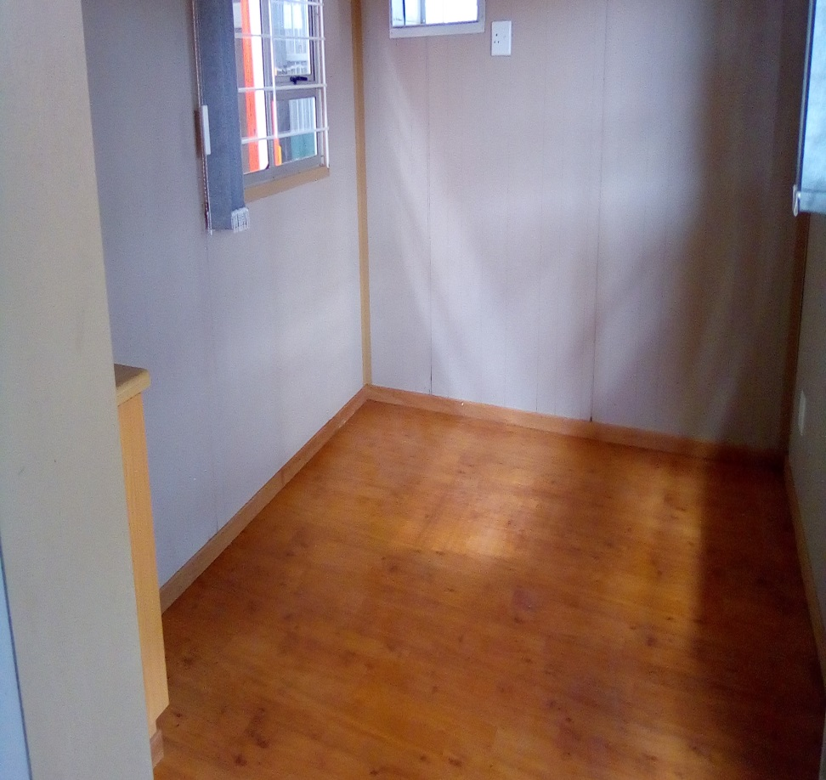
Children Ministry Class rooms what will be utilized during the week as pre-school class
Movable Class room
In site the class

Slide 12
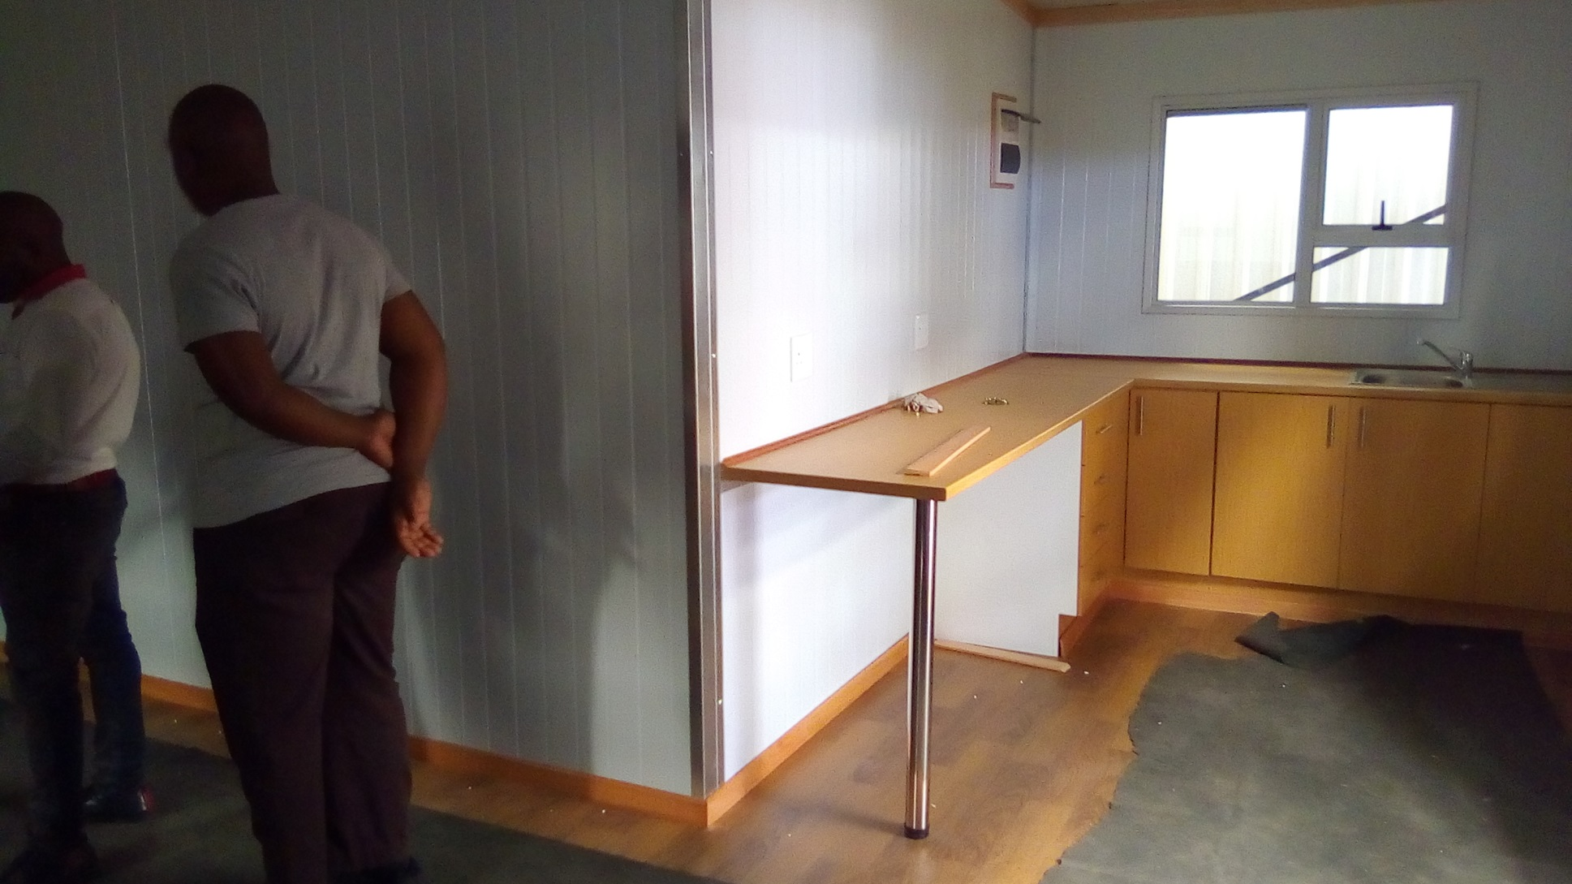
The Cost of Phase Three Church
Office and kitchen

Slide 13

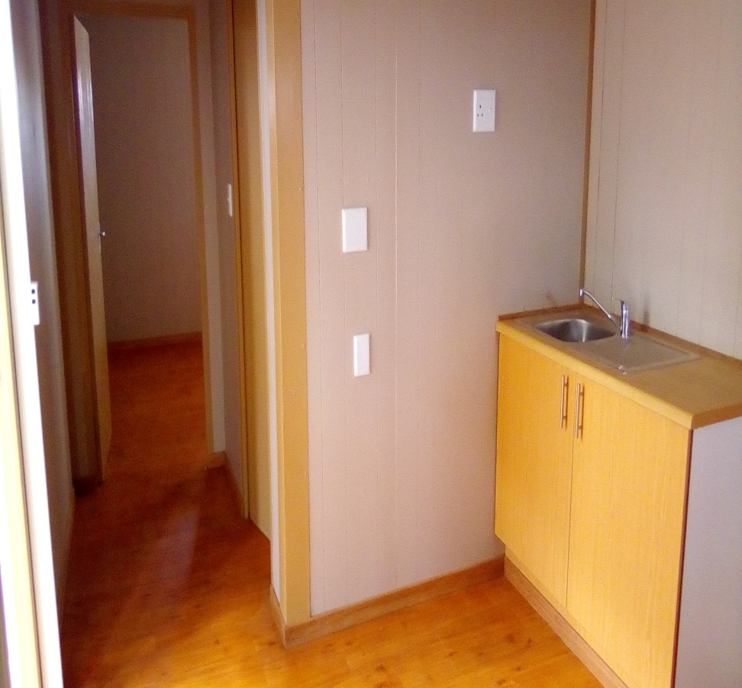
Office and kitchen
Office
Kitchen

Slide 14
Contribution Received Church Members and donnas for Phase One
Target is R 229,161.00 in $ 16,368.00
No | Name of the organisation | Contribute for | Amount | In Dallas
01 | COLLAGE SAMUEL-LEVI |  | R 7600 | $ 700

Slide 15
Contribution Received from Church Members and donnas
Target is R 229,161.00 in $ 16,368.00
50% we need for deposit is
R 114,580.00 in $ 8,184.32
No | Out Target | Rand | Dallas
01 | The amount we need for the work of phase one | R 229,161.00 | $ 16,368.00
02 | The amount we have receive | R 7.600,00 | $ 700.00
03 | The amount we still need to reach our target | R 221,561.00 | $ 15.668,00

Slide 16
CHURCH CONTAINER PROJECT
FOR
DONATION
Our
Banking Details
CAPITEC BANK
Under the Name of Fellowship Family Church
Accourt Number: 1614829282 type of Account: saving
Branch code: 470010
CONTACT
Pastor David Masongezi E.
E-mail: familyfoundationfellowship49@gmail.com
Cell:+27 72 339 6713 whastApp +27 73 651 8471
SKYPE: David & Cathy Masongezi

